Slide 1

Elementary Statistics
Thirteenth Edition
Chapter 8
Hypothesis Testing
Copyright © 2018, 2014, 2012 Pearson Education, Inc. All Rights Reserved

Slide 2
Hypothesis Testing
8-1 Basics of Hypothesis Testing
8-2 Testing a Claim about a Proportion
8-3 Testing a Claim About a Mean
8-4 Testing a Claim About a Standard Deviation or Variance

Slide 3
Key Concept
In this section we present key components of a formal hypothesis test. The concepts in this section are general and apply to hypothesis tests involving proportions, means, or standard deviations or variances.

Slide 4
Hypothesis and Hypothesis Test
Hypothesis
In statistics, a hypothesis is a claim or statement about a property of a population.
Hypothesis Test
A hypothesis test (or test of significance) is a procedure for testing a claim about a property of a population.

Slide 5
Example: Majority of Consumers are not Comfortable with Drone Deliveries (1 of 6)
1009 consumers were asked if they are comfortable with having drones deliver their purchases, and 54% (or 545) of them responded with “no.” Using p to denote the proportion of consumers not comfortable with drone deliveries, the “majority” claim is equivalent to the claim that the proportion is greater than half, or p > 0.5. The expression p > 0.5 is the symbolic form of the original claim.

Slide 6
Example: Majority of Consumers are not Comfortable with Drone Deliveries (2 of 6)
The Big Picture We have the claim that the population proportion p is such that p > 0.5. Among 1009 consumers, how many do we need to get a significantly high number who are not comfortable with drone delivery?
A result of 506 (or 50.1%) is just barely more than half, so 506 is clearly not significantly high.
A result of 1006 (or 99.7%) is clearly significantly high. But what about the result of 545 (or 54.0%) that was actually obtained in the Pitney Bowes survey?
Is 545 (or 54.0%) significantly high? The method of hypothesis testing allows us to answer that key question.

Slide 7
Example: Majority of Consumers are not Comfortable with Drone Deliveries (3 of 6)
Using Technology It is easy to obtain hypothesis-testing results using technology. The accompanying screen displays show results from four different technologies, so we can use computers or calculators to do all of the computational heavy lifting.

Slide 8
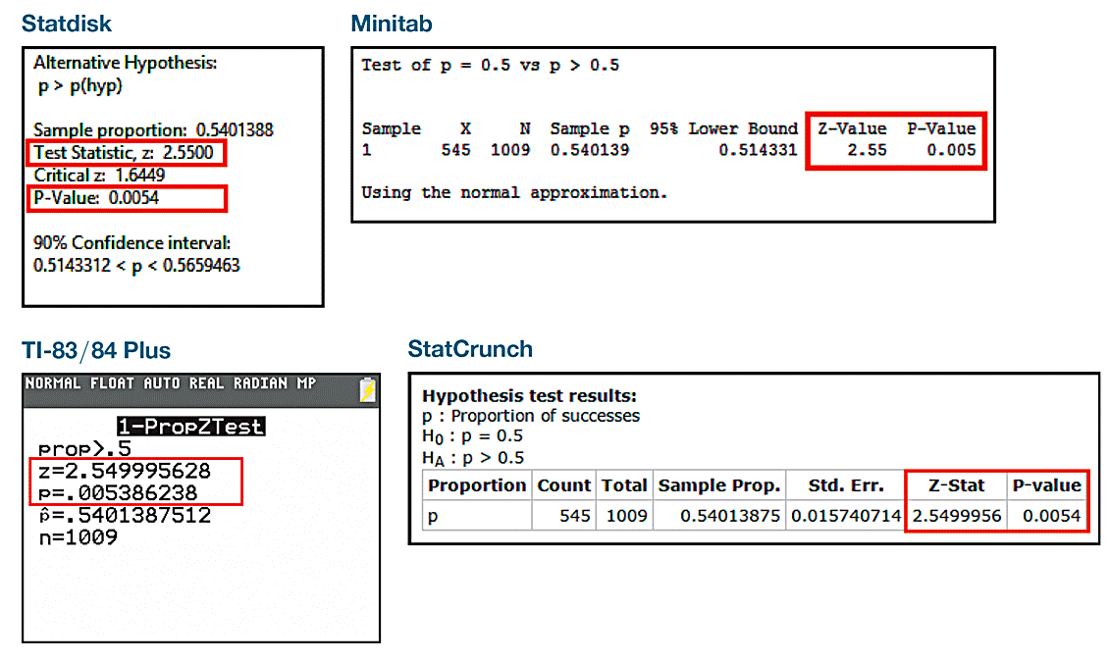
Example: Majority of Consumers are not Comfortable with Drone Deliveries (4 of 6)
Using Technology

Slide 9
Example: Majority of Consumers are not Comfortable with Drone Deliveries (5 of 6)
Using Technology
Examining the four screen displays, we see some common elements. They all display a “test statistic” of z = 2.55 (rounded), and they all include a “P-value” of 0.005 (rounded).
Focus on understanding how the hypothesis-testing procedure works and learn the associated terminology. Only then will results from technology make sense.

Slide 10
Example: Majority of Consumers are not Comfortable with Drone Deliveries (6 of 6)
Significance
Hypothesis tests are also called tests of significance. In Section 4-1 we used probabilities to determine when sample results are significantly low or significantly high. This chapter formalizes those concepts in a unified procedure that is used often throughout many different fields of application.

Slide 11
Null Hypothesis
Null Hypothesis
The null hypothesis (denoted by H₀) is a statement that the value of a population parameter (such as proportion, mean, or standard deviation) is equal to some claimed value.

Slide 12
Alternative Hypothesis
Alternative Hypothesis
The alternative hypothesis (denoted by H₁ or H_{a} or H_{A}) is a statement that the parameter has a value that somehow differs from the null hypothesis. For the methods of this chapter, the symbolic form of the alternative hypothesis must use one of these symbols: <, >, ≠.

Slide 13
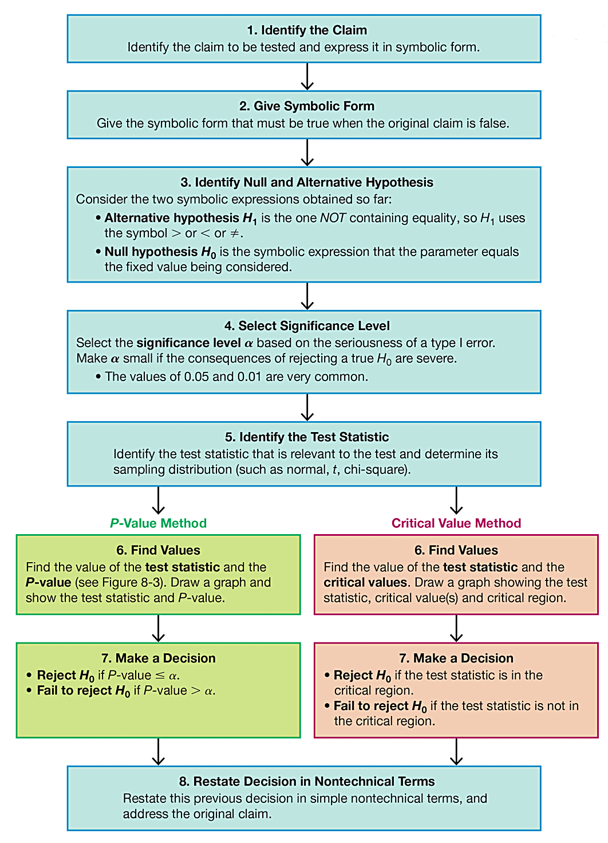
Procedure for Hypothesis Tests

Slide 14
Confidence Interval Method
Confidence Interval Method
Construct a confidence interval with a confidence level selected as in Table 8-1.
Table 8-1 Confidence Level for Confidence Interval
Significance Level for Hypothesis Test | Two-Tailed Test | One-Tailed Test
0.01 | 99% | 98%
0.05 | 95% | 90%
0.10 | 90% | 80%
Because a confidence interval estimate of a population parameter contains the likely values of that parameter, reject a claim that the population parameter has a value that is not included in the confidence interval.

Slide 15
Use the Original Claim to Create a Null Hypothesis H₀ and an Alternative Hypothesis H₁
Step 1. Identify the claim to be tested and express it in symbolic form.
Step 2. Give the symbolic form that must be true when the original claim is false.
Step 3. Consider the two symbolic expressions obtained so far:
Alternative hypothesis H₁ is the one NOT containing equality, so H₁ uses the symbol < or > or ≠.
Null hypothesis H₀ is the symbolic expression that the parameter equals the fixed value being considered.

Slide 16
Example: Drone Delivery (1 of 8)
Given the claim that “the majority of consumers are uncomfortable with drone delivery,” we can apply Steps 1, 2, and 3 as follows.

Slide 17
Example: Drone Delivery (2 of 8)
Step 1: Identify the claim to be tested and express it in symbolic form. Using p to denote the probability of selecting a consumer uncomfortable with drone delivery, the claim that “the majority is uncomfortable with drone delivery” can be expressed in symbolic form as p > 0.5.
Step 2: Give the symbolic form that must be true when the original claim is false. If the original claim of p > 0.5 is false, then p ≤ 0.5 must be true.

Slide 18
Example: Drone Delivery (3 of 8)
Step 3: This step is in two parts: Identify the alternative hypothesis H₁ and identify the null hypothesis H₀.
Identify H₁: Using the two symbolic expressions p > 0.5 and p ≤ 0.5, the alternative hypothesis H₁ is the one that does not contain equality. Of those two expressions, p > 0.5 does not contain equality, so we get H₁: p > 0.5
Identify H₀: The null hypothesis H₀ is the symbolic expression that the parameter equals the fixed value being considered, so we get H₀: p = 0.5

Slide 19
Step 4: Significance Level α
Significance Level
The significance level α for a hypothesis test is the probability value used as the cutoff for determining when the sample evidence constitutes significant evidence against the null hypothesis. By its nature, the significance level α is the probability of mistakenly rejecting the null hypothesis when it is true:
Significance level α = P (rejecting H₀ when H₀ is true)

Slide 20
Select the Significance Level α
Step 4. The significance level α is the same α introduced in sections 7-1, where we defined “critical value”. Common choices for α are 0.05, 0.01, and 0.10; 0.05 is most common.

Slide 21
Identify the test statistic that is relevant to the test and determine its sampling distribution (such as normal, t, χ²) (1 of 2)
Step 5. Identify the test statistic that is relevant to the test and determine its sampling distribution (such as normal, t, χ²). The table on the following slide lists parameters along with the corresponding sampling distributions.

Slide 22
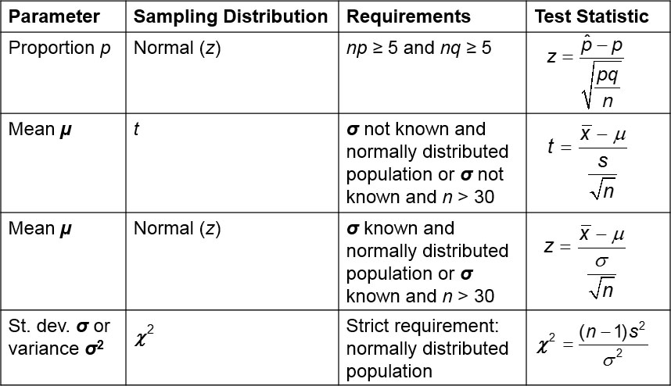
Identify the test statistic that is relevant to the test and determine its sampling distribution (such as normal, t, χ²) (2 of 2)

Slide 23
Example: Drone Delivery (4 of 8)
The claim p > 0.5 is a claim about the population proportion p, so use the normal distribution, provided that the requirements are satisfied. (With n = 1009, p = 0.5, and q = 0.5 from the ongoing example, np ≥ 5 and nq ≥ 5 are both true.)

Slide 24
Find the Value of the Test Statistic, Then Find Either the P-Value or the Critical Values(s)
Step 6. Find the value of the test statistic and the P-value or critical value(s).

Slide 25
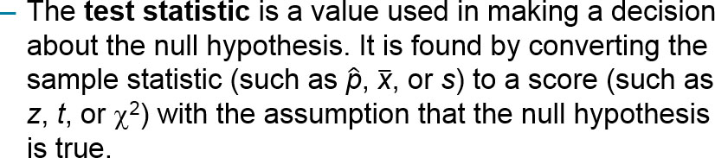
Test Statistic
Test Statistic

Slide 26
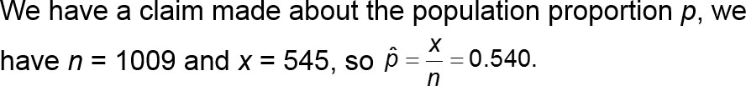
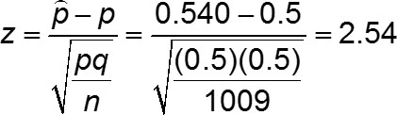
Example: Drone Delivery (5 of 8)
With the null hypothesis of H₀: p = 0.5, we are working with the assumption that p = 0.5, and it follows that q = 1 − p = 0.5. We can evaluate the test statistic as shown below. The test statistic of z = 2.55 from each of the previous technology displays is more accurate than the result of z = 2.54 shown below.

Slide 27
Critical Region
Critical Region
The critical region (or rejection region) is the area corresponding to all values of the test statistic that cause us to reject the null hypothesis.

Slide 28
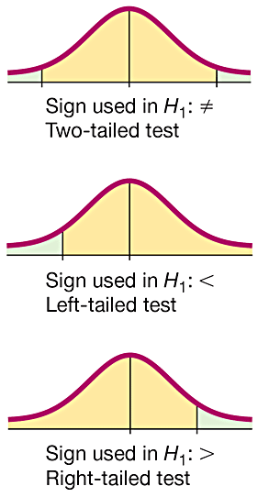
Two-Tailed, Left-Tailed, Right-Tailed
Two-tailed test: The critical region is in the two extreme regions (tails) under the curve.
Left-tailed test: The critical region is in the extreme left region (tail) under the curve.
Right-tailed test: The critical region is in the extreme right region (tail) under the curve.

Slide 29
P-Value Method
P-Value Method
In a hypothesis test, the P-value is the probability of getting a value of the test statistic that is at least as extreme as the test statistic obtained from the sample data, assuming that the null hypothesis is true.

Slide 30
Example: Drone Delivery (6 of 8)
Using the data from the previous problem, the test statistic is z = 2.55, and it has a normal distribution area of 0.0054 to its right, so a right-tailed test with test statistic z = 2.55 has a P-value of 0.0054. See the different technology displays given earlier, and note that each of them provides the same P-value of 0.005 after rounding.

Slide 31
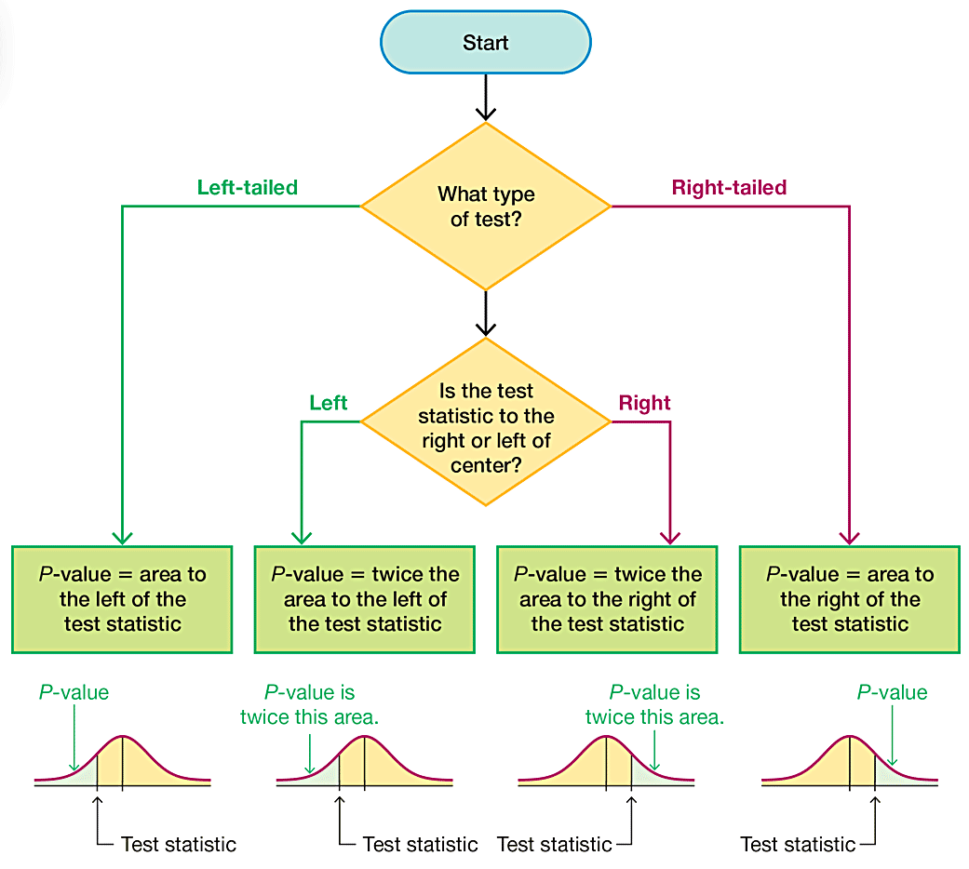
Finding P-Values

Slide 32
Caution
P-value = probability of a test statistic at least as extreme as the one obtained
p = population proportion

Slide 33
Critical Value Method
Critical Values
In a hypothesis test, the critical value(s) separates the critical region (where we reject the null hypothesis) from the values of the test statistic that do not lead to rejection of the null hypothesis.

Slide 34
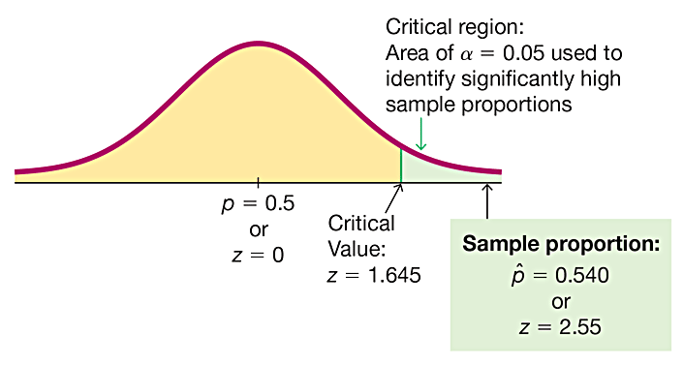
Example: Drone Delivery (7 of 8)
The critical region is shaded in green. The figure shows that with a significance level of α = 0.05, the critical value is z = 1.645.

Slide 35
Make a decision to Either Reject H₀ or Fail to Reject H₀
Step 7. Make a decision to either reject H₀ or fail to reject H₀.
Decision Criteria for the P-Value Method:
If P-value ≤ α, reject H₀ (“If the P is low, the null must go.”)
If P-value > α, fail to reject H₀.

Slide 36
Restate the Decision Using Simple and Nontechnical Terms
Step 8. Restate the decision using simple and nontechnical terms.
Without using technical terms not understood by most people, state a final conclusion that addresses the original claim with wording that can be understood by those without knowledge of statistical procedures.

Slide 37
Example: Drone Delivery (8 of 8)
There is sufficient evidence to support the claim that the majority of consumers are uncomfortable with drone deliveries.

Slide 38
Restate the Decision Using Simple and Nontechnical Terms (1 of 4)
Wording the Final Conclusion
For help in wording the final conclusion, refer to the table on the next slide, which lists the four possible circumstances and their corresponding conclusions.
Note that only the first case leads to wording indicating support for the original conclusion. If you want to support some claim, state it in such a way that it becomes the alternative hypothesis, and then hope that the null hypothesis gets rejected.

Slide 39
Restate the Decision Using Simple and Nontechnical Terms (2 of 4)
Wording the Final Conclusion
Condition | Conclusion
Original claim does not include equality, and you reject H₀. | “There is sufficient evidence to support the claim that … (original claim)”
Original claim does not include equality, and you fail to reject H₀. | “There is not sufficient evidence to support the claim that … (original claim)”
Original claim includes equality, and you reject H₀. | “There is sufficient evidence to warrant rejection of the claim that … (original claim).”
Original claim includes equality, and you fail to reject H₀. | “There is not sufficient evidence to warrant rejection of the claim that … (original claim).”

Slide 40
Restate the Decision Using Simple and Nontechnical Terms (3 of 4)
Accept or Fail to Reject?
We should say that we “fail to reject the null hypothesis” instead of saying that we “accept the null hypothesis.” The term accept is misleading, because it implies incorrectly that the null hypothesis has been proved, but we can never prove a null hypothesis. The phrase fail to reject says more correctly that the available evidence isn’t strong enough to warrant rejection of the null hypothesis.

Slide 41
Restate the Decision Using Simple and Nontechnical Terms (4 of 4)
Multiple Negatives
Final conclusions can include as many as three negative terms. For such confusing conclusions, it is better to restate them to be understandable. Instead of saying that “there is not sufficient evidence to warrant rejection of the claim of no difference between 0.5 and the population proportion,” a better statement would be this: “Until stronger evidence is obtained, continue to assume that the population proportion is equal to 0.5.”

